Slide 1

Exploratory Data Analysis
G2M Case Study
Virtual Internship
October 13, 2021

Slide 2

Agenda
Problem Statement
Data Exploration
EDA
Recommendations

Slide 3
Problem Statement
Task
The Client
XYZ is a private firm in US. Due to remarkable growth in the Cab Industry in last few years and multiple key players in the market, it is planning for an investment in Cab industry and as per their Go-to-Market(G2M) strategy they want to understand the market before taking final decision.
Project delivery:
You have been provided with multiple data sets that contains information on 2 cab companies. Each file (data set) provided represents different aspects of the customer profile. XYZ is interested in using your actionable insights to help them identify the right company to make their investment.
The outcome of your delivery will be a presentation to XYZ’s Executive team. This presentation will be judged based on the visuals provided, the quality of your analysis and the value of your recommendations and insights.

Slide 4
Data Exploration
Data Intake
 | Number of entries | Number of attributes
Cab_Data.csv | 359392 | 7
Customer_ID.csv | 49171 | 4
Transaction_ID.csv | 440098 | 3
City.csv | 20 | 3
Cab_Data.csv
Customer_ID.csv
Transaction_ID.csv
City.csv
The available data was quite clean.
No duplicates were found; only 2 columns required data transformation.
To facilitate analysis, columns of different tables were combined to create more meaningful tables.
The data spans a 3-year period (January 2016 to December 2018)

Slide 5
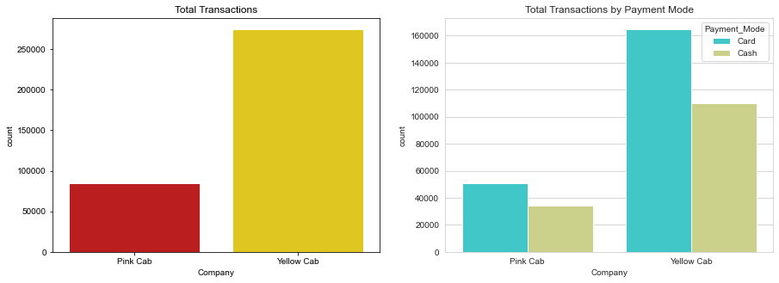
EDA: 1. Transaction Overview
From the plot below, we can see that the Yellow Cab company has overwhelmingly processed more transactions than Pink Cab. For both companies, the majority of payments where made by Card. This suggests that users of both cab companies find this payment method more convenient.

Slide 6
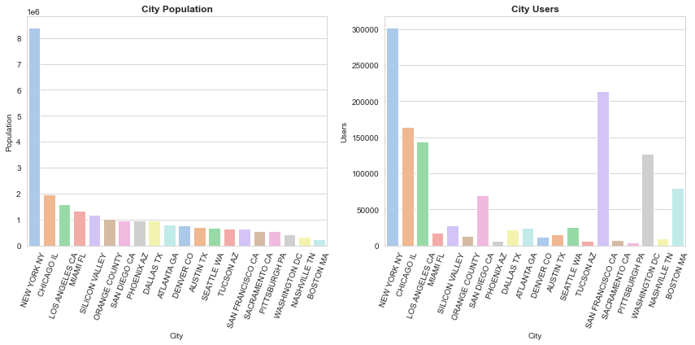
EDA: 2. Locations
We can get more insight into the transactions by further classifying them by the locations where they occurred. Most of the transactions occurred in Chicago and New York.

Slide 7
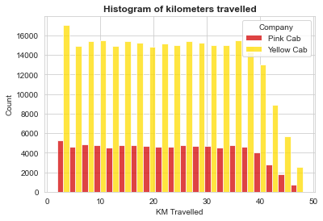
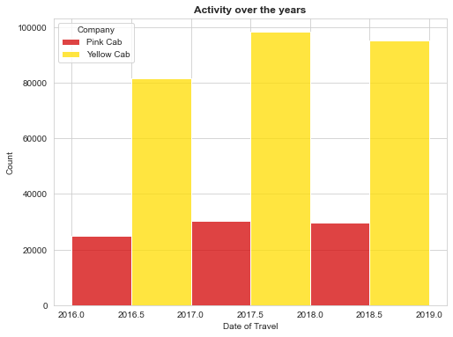
EDA: 3. Car Ride Activities
If we look at the histograms of the number of kilometers/ride, we observe that the distances are uniformly distributed between 0 km and 40 km. Fewer rides exceed 40 kilometers.
By plotting a histogram of the dates of the transactions over the 2016-2018 period, we observe that both companies recorded their highest number of activities in 2017 and 2018

Slide 8
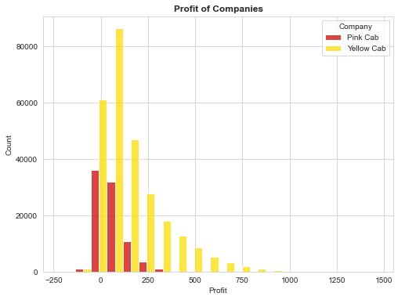
EDA: 4. Financial History of Companies
By plotting a histogram of the profits, we readily see that Yellow Cab has had higher earnings. This totally makes sense given that they have processed more transactions than Pink Cab.

Slide 9
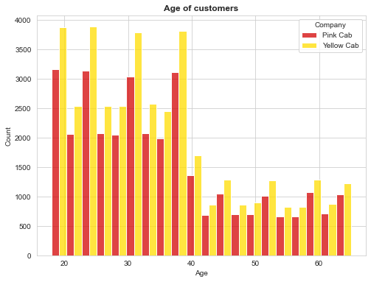
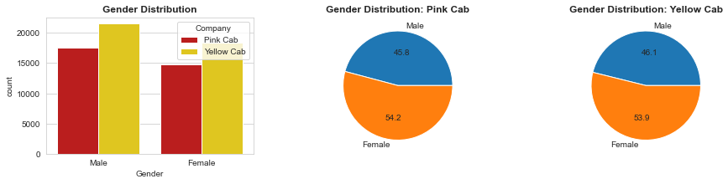
EDA: 5. Profile of Customers
Most cab riders are 40-year-old or younger.
Males used cab riding services more often than females

Slide 10
Recommendations
Summary
After analysis, we made the following observations:
Yellow Cab has processed more transactions than Pink Cab. Users of both companies prefer using card for payment.
There is a hot marketplace in New York and Chicago.
Typical car rides do not exceed 40 kilometers.
Yellow Cab is more profitable than Pink Cab
The majority of cab riders are 40-year-old or younger.
Recommendations
Given its profitable history, we recommend Yellow Cab for investment.
Your main target cities should be New York and Chicago, and target population, young as well as middle-aged adults.
Given that most payments occur by card, we recommend setting up business models that take advantage of that fact.

Slide 11
Thank You

